Slide 1
Field Weakening
FSE RACING KIT

Slide 2


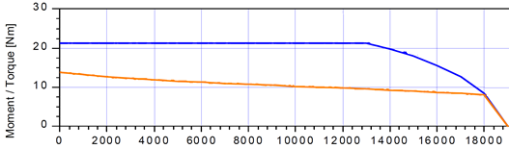
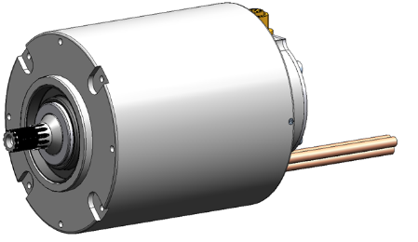
Relationship HV voltage between motor speed and torque
If the output voltage Us of the inverter is
mainly needed to counteract the induced voltage,
there is no voltage available to regulate
the Iq current (torque-forming current).
The torque-forming current decreases
and the motor speed cannot increase any further.
HV input voltage
… is limited by
the battery voltage
Inverter output voltage U_{s}
… is limited by
the HV voltage
(Iq)
Terminal
voltage
motor
The terminal voltage* at the motor increases with increasing speed.
* Induced voltage U_{p} (increases with increasing speed) + voltage drop at the winding.
The induced voltage U_{p} counteracts the output voltage Us.

Slide 3
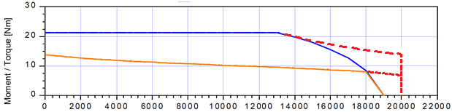
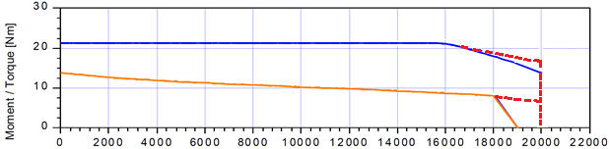
Operation with Field Weakening
- - - - Torque curve in field weakening
Torque curve at HV 500 VDC
A permanent magnet synchronous motor
with field weakening
can reach higher speeds,
with simultaneously, only slowly reducing motor torque.
In addition, control reserves
in the area of the characteristic speed point are reached.
max. motor torque
rated motor torque
Torque curve at HV 600 VDC
The entry point into the field weakening shifts
depending on the HV voltage.
max. motor torque
rated motor torque

Slide 4
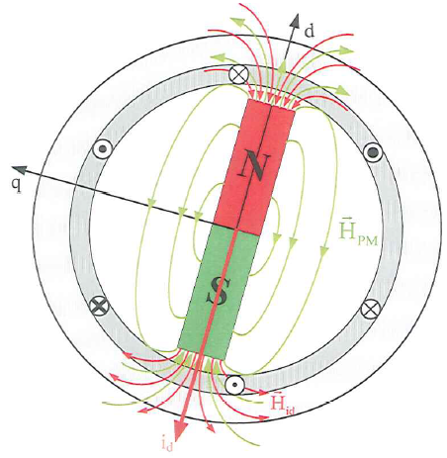

Operation with Field Weakening
Reminder:
The induced motor voltage U_{p} (increases with increasing speed)
counteracts the inverter output voltage U_{s}
and prevents the further increase of the speed.
i_{q} torque current
Field Weakening functionality
During field weakening, a negative magnetizing current i_{d} is impressed.
The field of the magnetizing current i_{d} counteracts the field of the permanent magnet.
The magnetic flux ψ is reduced, which also reduces the induced voltage.
As a result, the terminal voltage decreases.
This means that the inverter has voltage available again for control the Iq current.
If the output voltage of the inverter remains constant, the output frequency (speed) can be increased.
The speed can increase further.
i_{d} magnetizing current
Disadvantage:
Additional power losses due to the magnetizing current i_{d}. Therefore, the torque current must be reduced in order not to overheat the motor.

Slide 5
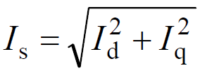
Vector Diagram
Ohmic voltage drop neglected
Max. Output voltage inverter (stator voltage) Us = constant
q
Field weakening operation
U_{p} ~ ω
Normal operation
X_{s}I_{sd}
q
X_{s}I_{s}
X_{s}I_{s}
X_{s}I_{sq}
Power 100 %
Speed 100 %
Torque 100 %
Is = Iq = 20 A
Id = 0 A
U_{s}
U_{p} ~ ω
U_{s}
Power 100 %
Speed 185 %
Torque 60 %
I_{s} = 20 A
I_{q} = 12 A
I_{d} = 16 A
I_{s} = I_{sq}
I_{s}
I_{sq}
ψ_{p}
I_{sd}
ψ_{p}
d
d

Slide 6
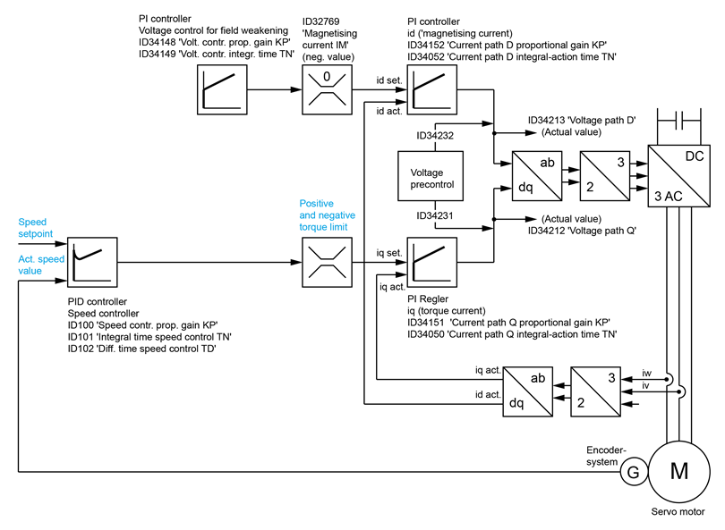
Over View Control Structure
control structure
field weakening
Speed
controller
Current
controller

Slide 7


Acceleration and Entry Point into the Field Weakening
The entry point into the field weakening is not fixed,
it shifts through the variable HV voltage.
Entry into the field weakening
Usq
at motor voltage U_{DC} > (HV voltage - Voltage reserve)
HV voltage
Voltage reserve
ID34212 'Voltage Usq' (motor torque)
ID34213 'Voltage Usd' (field weakening)
ID32836 'DC bus voltage' (HV voltage)
Usd
ID34266 'Voltage reserve'
Motor voltage U_{DC}

Slide 8
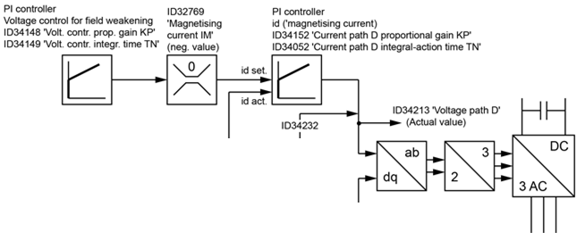
Entry Point into the Field Weakening
An optimized entry into the field weakening improves the performance of the engine.
The voltage control defines the settling properties of the field weakening current.
Usq
ID34148 'Voltage control proportional gain KP'
ID34149 'Voltage control integrating time TN'
HV voltage
Usd
Motor voltage U_{DC}

Slide 9
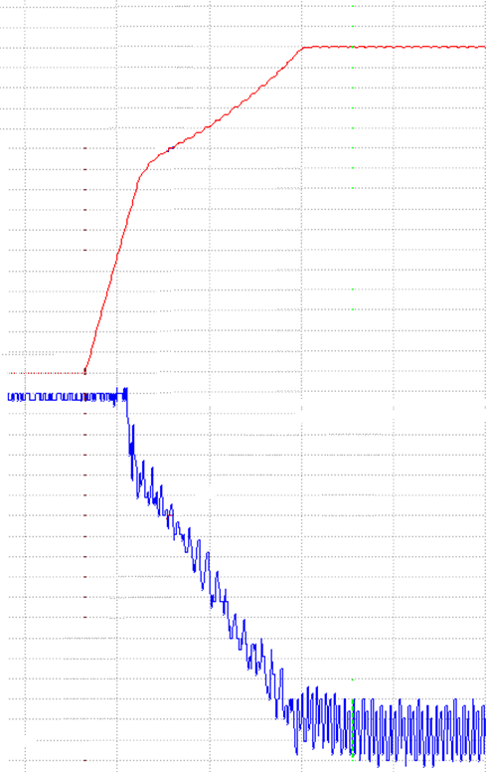
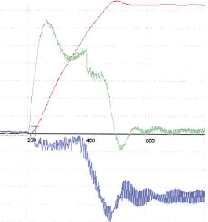
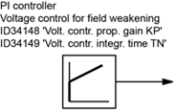
Entry Point into the Field Weakening
ID40 'Actual speed value'
(Kink) Entry into the field weakening
Objective:
Minimization of the kink in the actual speed value when entering the field weakening,
As small overshoot of the field weakening current.
ID33185 'Actual magnetizing current value'
ID40 'Actual speed value'
ID33186 'Actual torque current value'
ID34148 'Voltage control proportional gain KP'
ID34149 'Voltage control integrating time TN'
ID33185 'Actual magnetizing current value'

Slide 10
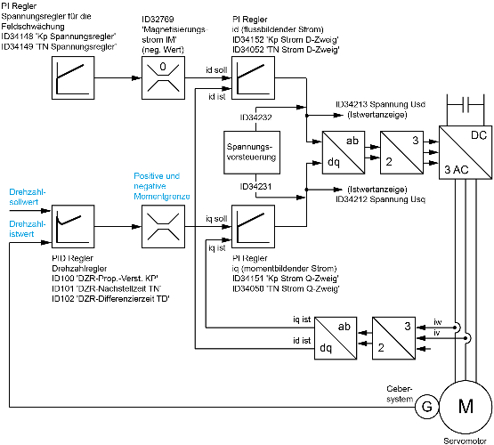
Optimization of Voltage Controller for Field Weakening
PID controller-
speed controller
ID101 'Speed Integral Time TN'
e. g. 20 ms
PI controller-
voltage controller for field weakening
ID34149 'Voltage Integral Time TN'
PI controller-
id (field weakening current)
ID34052 'Integral Time D'
iq (torque current)
ID34050 'Integral Time Q'
e. g. 1 ms
Start value
between speed und current controller
e. g. 10 ms
Oscillation
TN voltage controller at least
factor 2 to current controller

Slide 11
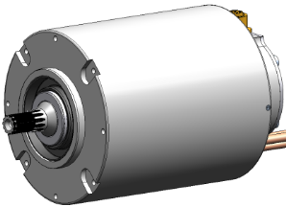



Total Currents with Field Weakening
Motor
$$I_{s}= \sqrt{I_{d}^{2}+I_{q}^{2}}$$
Inverter
The total current I_{s} is not automatically limited.
The total current I_{s} may exceed the maximum current motor in some situations.
The setpoint torque value must be adjusted.
If i²t monitoring motor is active, Id and Iq are taken into account. The FSE firmware limits the target torque.
Without I²t monitoring an inadmissible heating of the motor is possible.
ID32773 'Service bits', bit 14.
Imax = 105 A
fout > 1 Hz max. 10 s
fout ≤ 1 Hz max. 1 s
The inverter limits the output current in
field weakening to I_{max}
$$I_{max}= \sqrt{I_{d}^{2}+I_{q}^{2}}$$

Slide 12

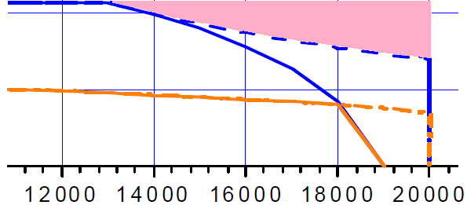
Setpoint Torque Value in Field Weakening
WARNING
 | Risk of unstable controller behavior The torque setpoint may not be higher than the maximum torque that can be made available from the motor at the current operating point. Possible consequences: Output terminal overcurrent (diagnoses-no. 2334), drive runs down Drive runs down (induced voltage > HV voltage = DC braking) Steps to prevent: Calculate maximum nominal torque specification and limit online
Entry point field weakening, setpoint torque input must be reduced
Target torque specifications
in the pink range
are not allowed.
The maximum motor torque in the field weakening depends on the HV voltage.
Change in the HV voltage,
especially when accelerating must be taken into account by the user.

Slide 13
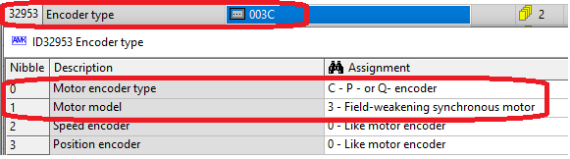

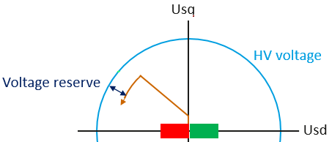
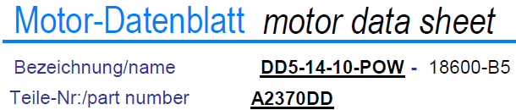
Parameterization Field Weakening
ID34266 'Voltage reserve'
The voltage reserve defines the reserve for the current controller.
Field weakening area starts at:
Motor voltage U_{DC} > (U_{DC-Bus} - ID34266)

